Slide 1
Statistics Review
Fischer
May 8

Slide 2
Rational Numbers
A character on the show named ‘Data’ is an android without emotions or feelings. He only has the ability to reason rationally based on his programming.
He processes everything based on a series of inputs and outputs, events and outcomes. The idea of a magic trick would not compute. There is only cause and effect.

Slide 3
IRRATIONAL NUMBERS
http://www.tubechop.com/watch/5875359
Jim Carrey in "Liar, Liar"
In the movie Jim Carrey plays a lawyer, named Fletcher, trying to get his client half of the marital assets from her divorce. Through the wish of his 6 year old son, Fletcher has lost the ability to lie, which limits his skills as a lawyer. In order to buy time until the wish, or curse, is lifted Fletcher determines the best way to get out of the proceedings is to beat the tar out of himself. 1. Think about how Fletcher's irrational behavior would compare to an irrational number. What are the characteristics of an irrational number?

Slide 4
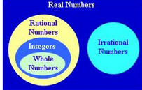
8NS1
2. A Rational number can be written as a _________.
3. An IRRATIONAL ‘crazy’ number NEVER_____ or _______. (It goes on and on and on…..)
4. WHY can’t all INTEGERS be WHOLE NUMBERS?

Slide 5
Game Time-8NS1
Visit the link and CLASSIFY http://www.quia.com/rr/896433.html?AP_rand=840265474

Slide 6
8NS2

Slide 7
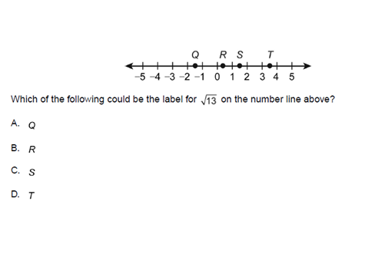
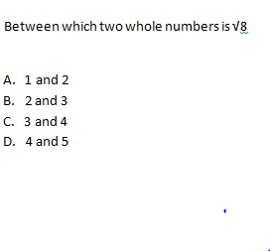
Create a number line with the values 1-15. SQUARE each variable

Slide 8
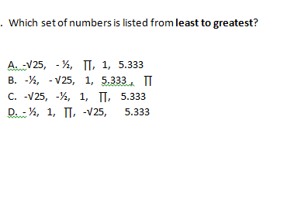

Slide 9
8EE1
Game Time
http://www.quia.com/ba/565227.html?AP_rand=457805656

Slide 10
8EE3
Your choice
*Visit the page and choose one of the items. Show your work.
http://stricklerwms.weebly.com/scientific-notation-8ee3---8ee4.html

Slide 11
Pythagorean Theorem Review
http://www.math-play.com/Pythagorean-Theorem-Jeopardy/Pythagorean-Theorem-Jeopardy.html

Slide 12
Graphing Linear Equations
http://www.mathplayground.com/SaveTheZogs/SaveTheZogs.html

Slide 13
Scatterplots
http://www.mathsisfun.com/data/scatter-xy-plots.html

