Slide 1
Transversal
Where is it?

Slide 2
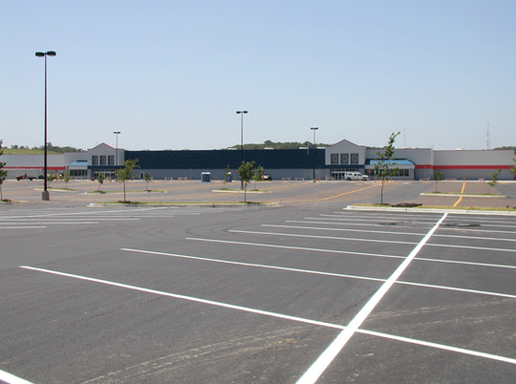
Can you find a pair of:
Supplementary Angles?
Interior Angles?

Slide 3
Can you find: Alternate Interior? Corresponding angles?

Slide 4
Can you find:
Vertical Angles?

Slide 5
What type of angles are these?

Slide 6
What type of angles do you see?

Slide 7
Partner
Take turns ASKING questions to one another.
EASY:
Can you identify the VERTICAL angles?
MEDIUM:
<A and <D are CORRESPONDING ANGLES True or FALSE?
HARD:
Is < 3 CONGRUENT to < 5?
CHALLENGE:
If <1 and <2 are SUPPLEMENTARY and <1 is 70 what is the value of <2?

